Slide 1
Palmyra / Cunningham town hall meeting
November 17, 2022

Slide 2
Purpose
Provide updates to completed and ongoing projects
Discuss upcoming projects and impacts
Discuss future projects to be expected

Slide 3
Completed/Current Projects
Updated minimum requirements for road construction to make them last longer
help save tax dollars on road repairs
Hired a dedicated construction inspector to ensure these requirements are met
help protect the tax payer’s investment in adequate infrastructure
Performed pavement condition survey to determine the condition of existing roads
help prioritize road repair based on road condition
Marthas Chapel Rd and Blackford Hills Rd repaving
Bend Rd, Bryant Hollow Rd, Grays Chapel Rd and Old Hwy 48 rejuvenation
Various pipe replacements

Slide 8
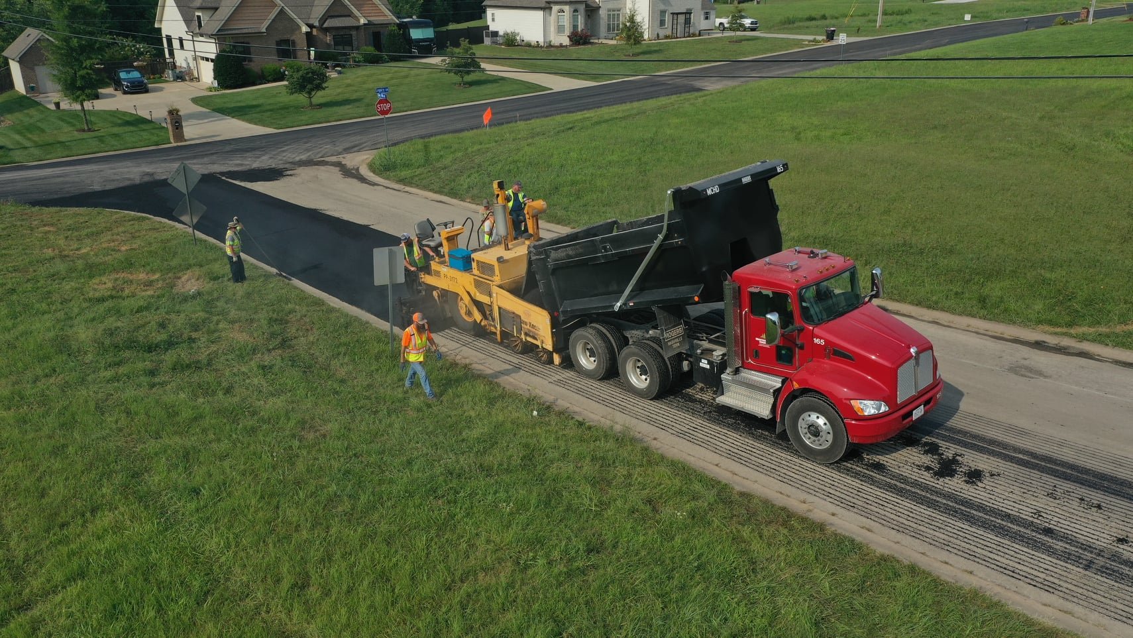
Plans for 2022
Paving
River Rd
Palmyra Road
Vernon Creek Road
Chapel Hill Road
Corbandale Road
Lock B Road S
Possum Hollow Road
Rejuvenation
Old Hwy 13

Slide 9
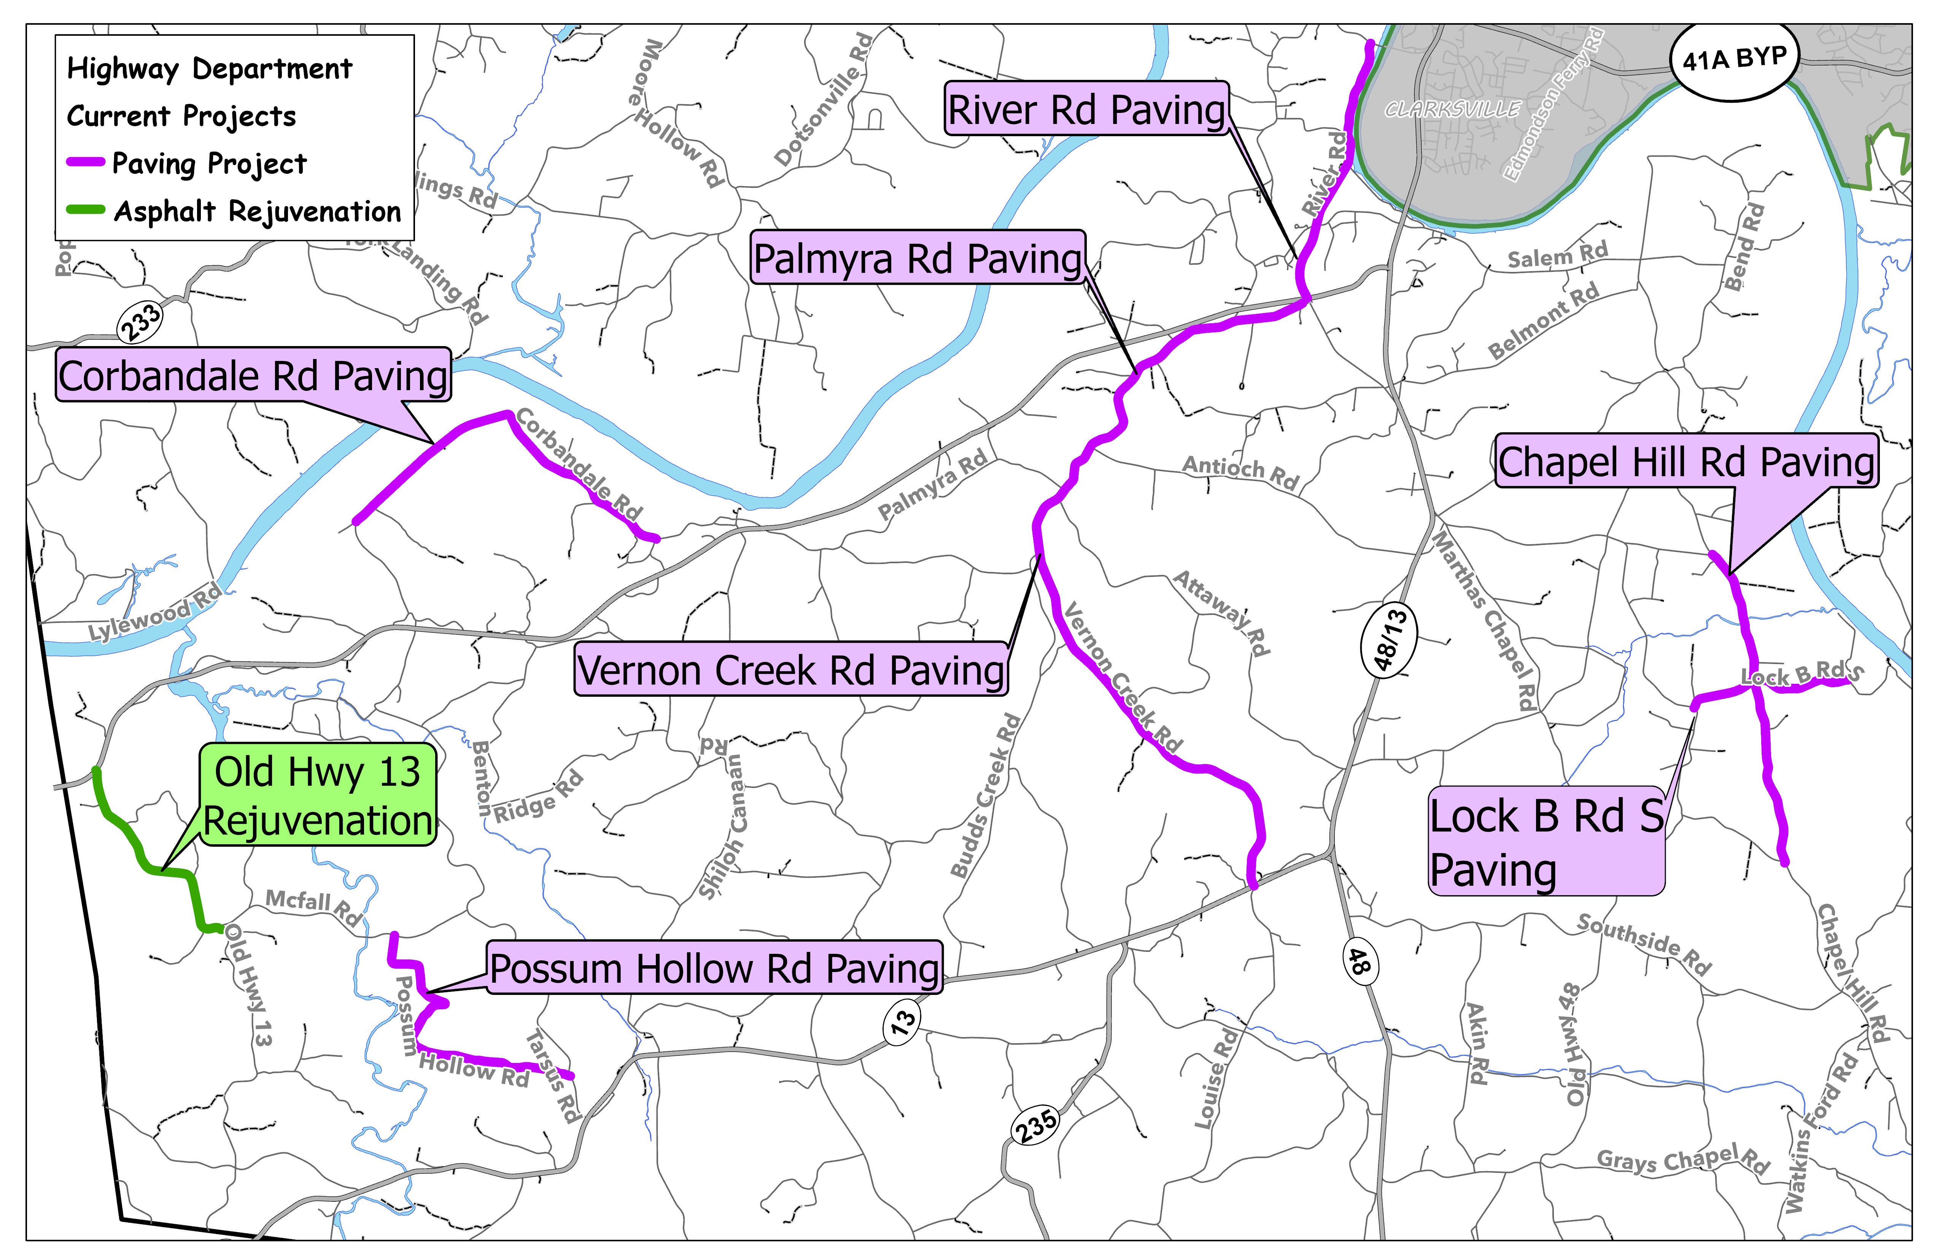
Completed

Slide 10
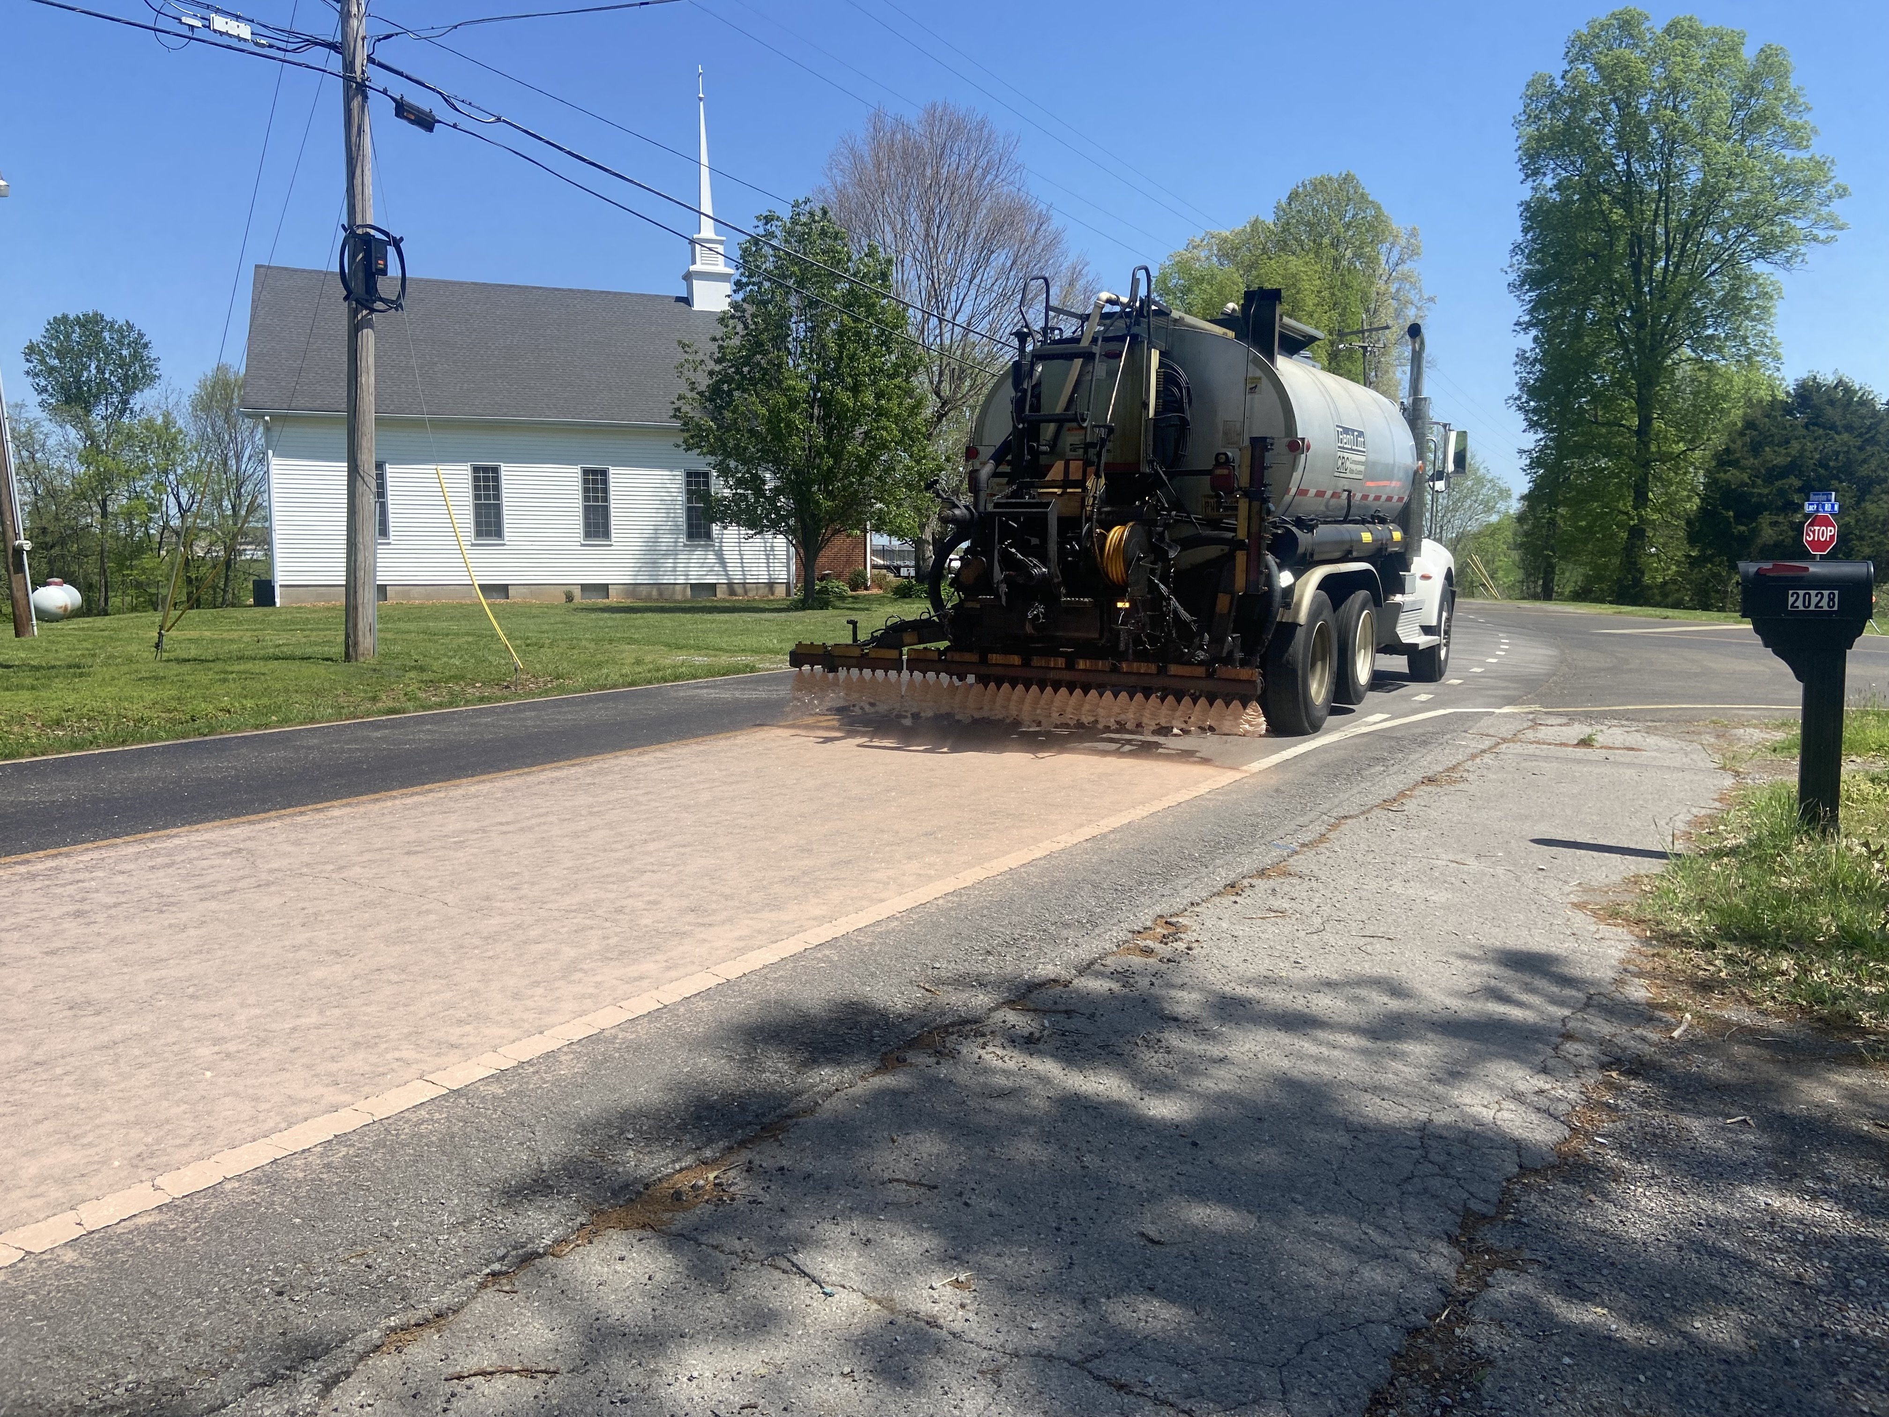
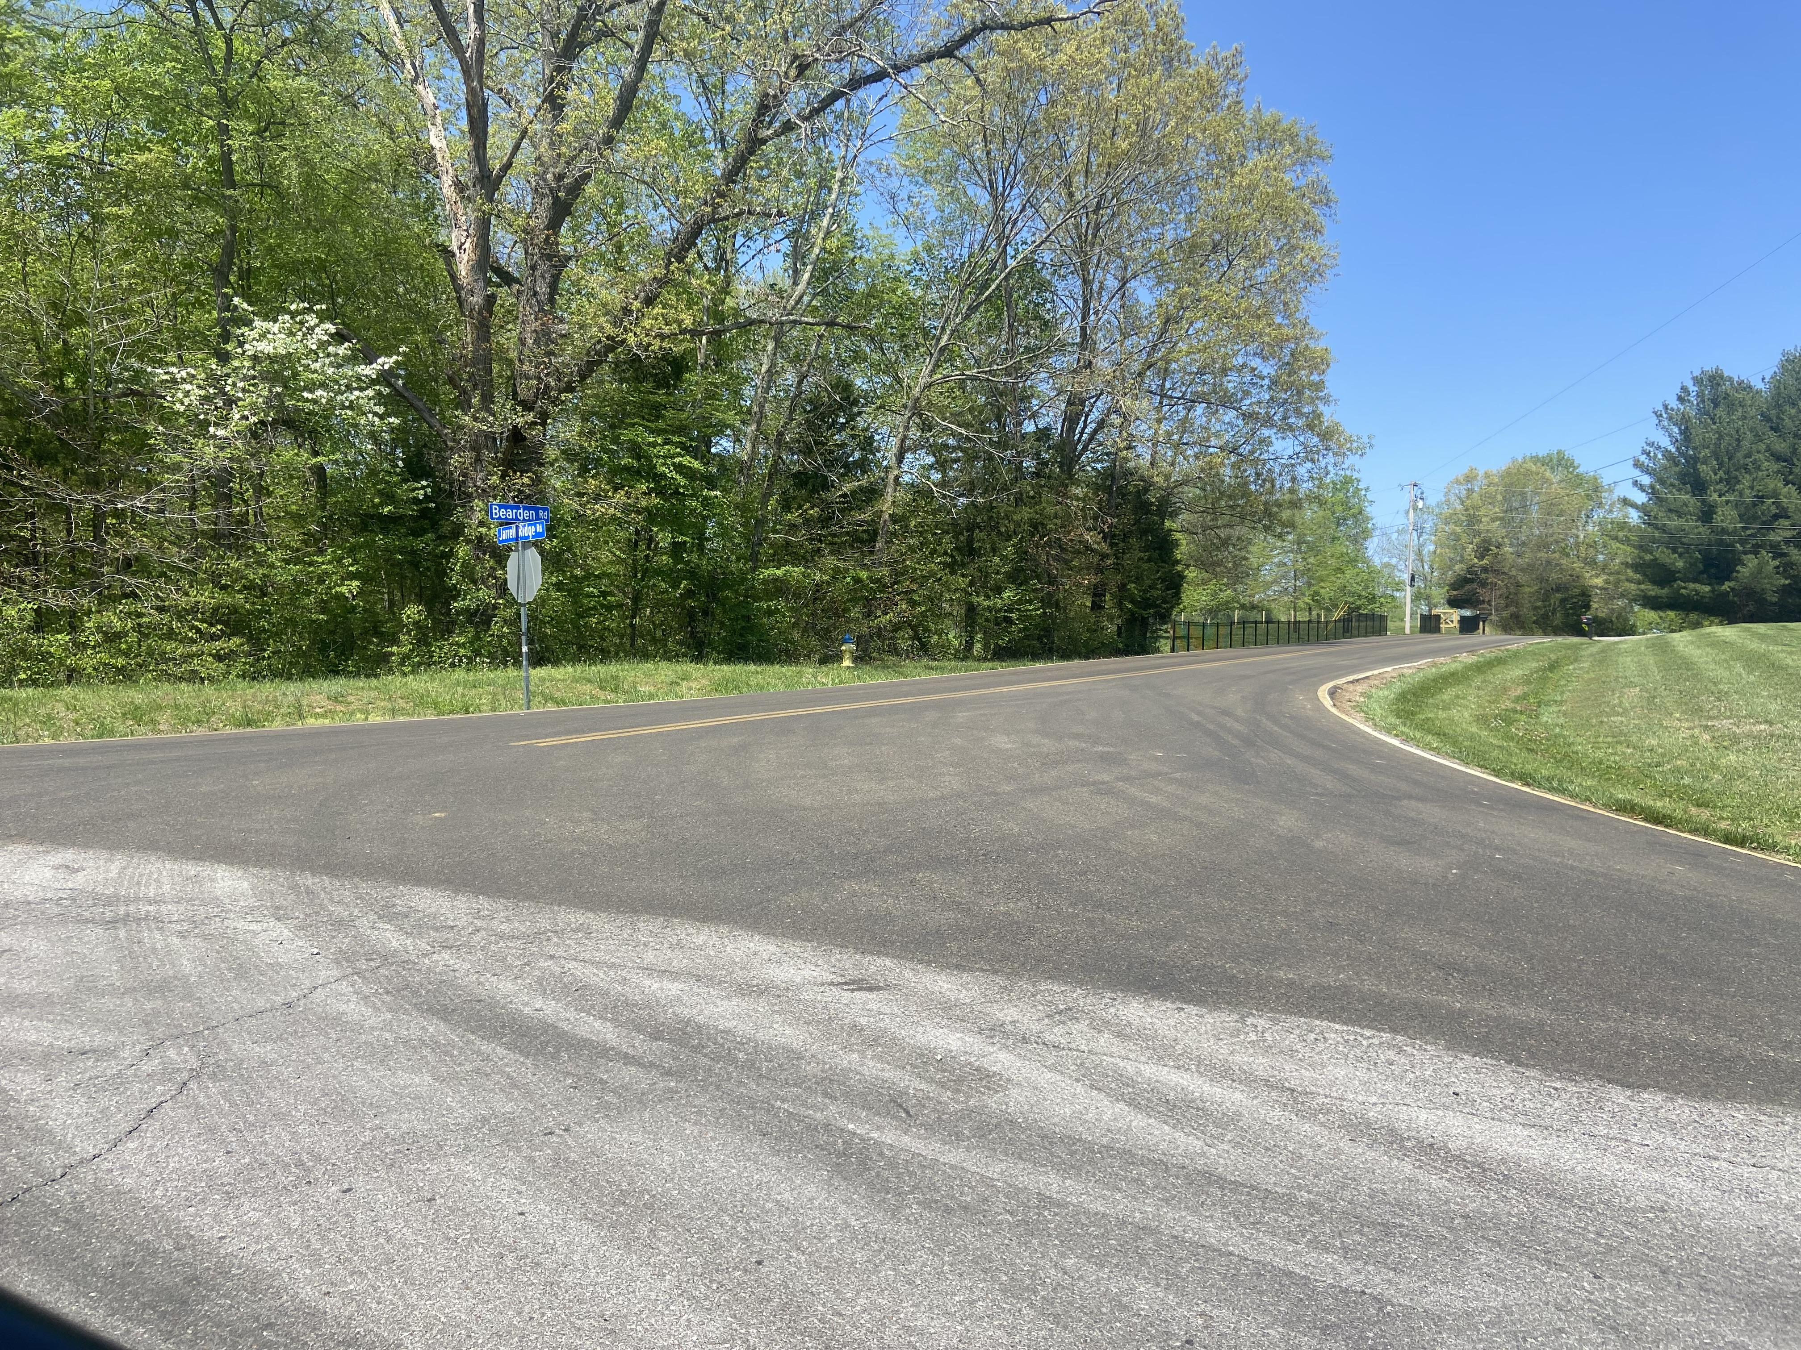
Rejuvenation

Slide 11
Future projects (within 5 years)
Intersection Improvement Project
Hwy 48/13
Old Hwy 48, Salem Ridge and Hwy 48/13
Seven Mile Ferry and Hwy 48/13
Hwy 48 and Hwy 13
TDOT – 374 Extension (Tentative completion by 2027)

Slide 12
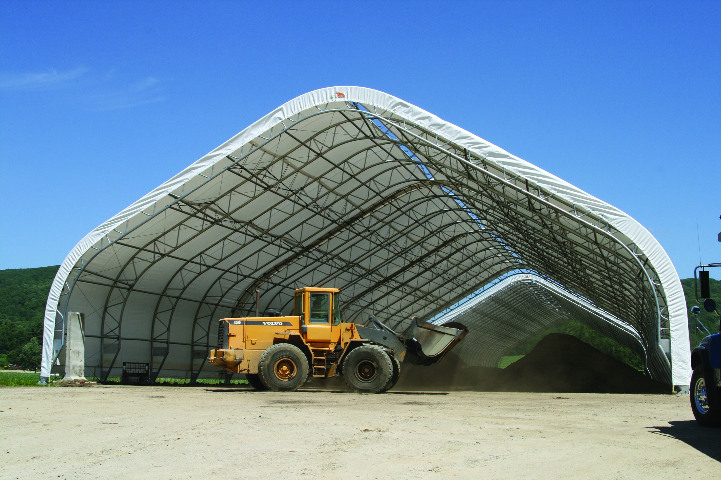
New Salt Shed
Salt Shed
Snow plows will have a closer facility to load salt, so they can finish snow routes more quickly.

Slide 13
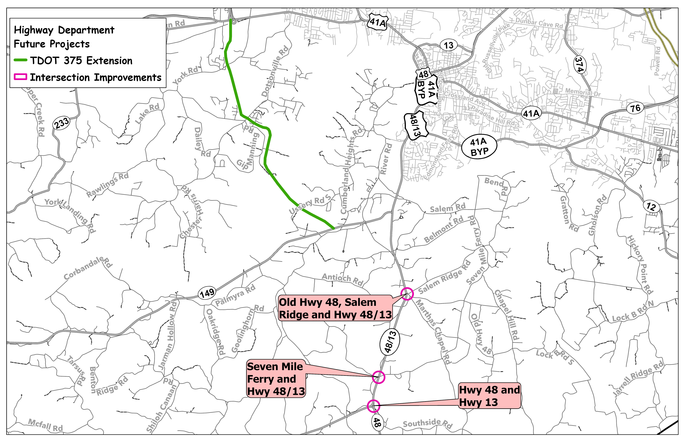
Future

Slide 14
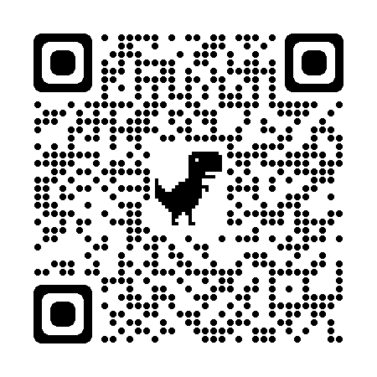
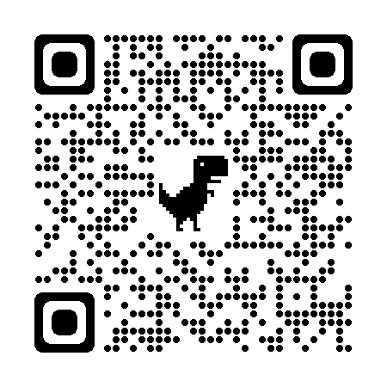
Questions
Contact Info
Montgomery County Highway Department
Phone : (931) 648-5740
Facebook: https://www.facebook.com/mcgtn.net/
Website: https://mcgtn.org/highway

